Slide 1
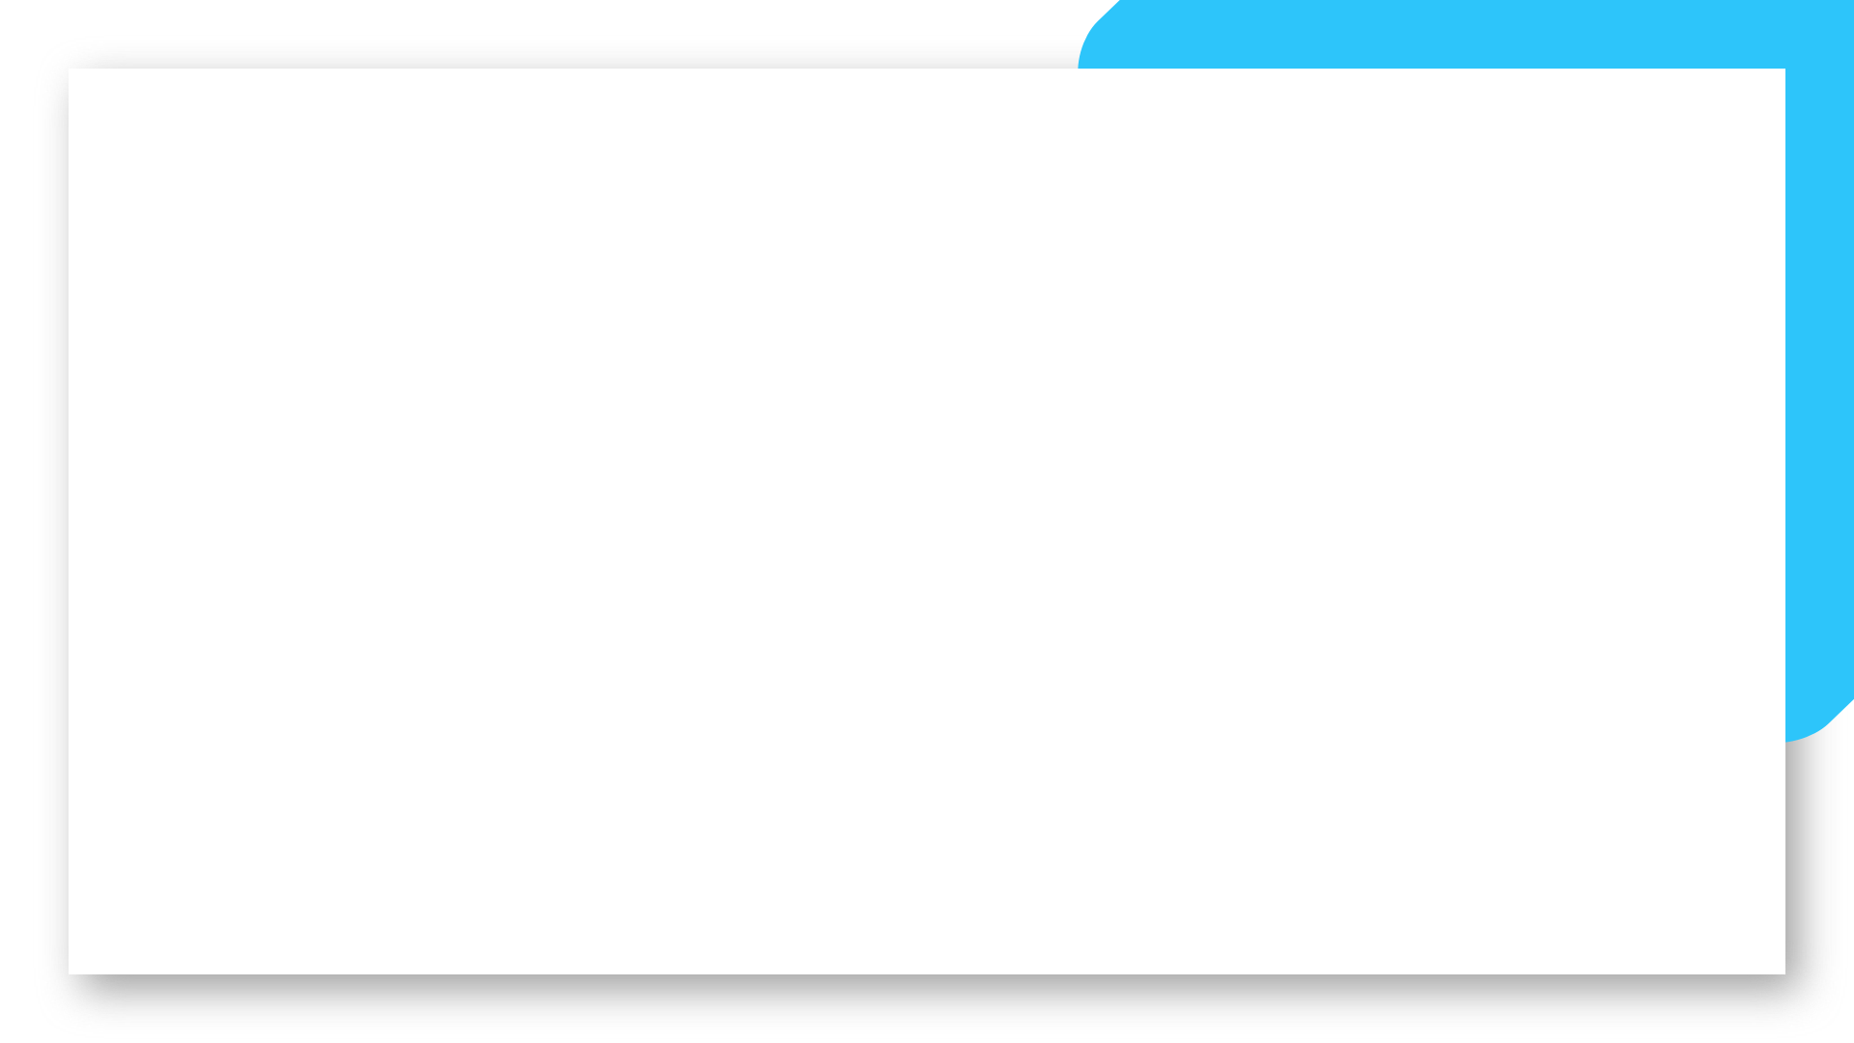
Events
Eventbrite Spain Madrid : https://www.eventbrite.es/d/spain--madrid/ux-ui/
Eventbrite Spain Barcelona: https://www.eventbrite.co/d/spain--barcelona/ux-ui-design/
Ida Blog
https://blog.ida.cl/experiencia-de-usuario/eventos-internacionales-ux-2020/
Digital product designer BCN
https://www.meetup.com/es-ES/Barcelona-Digital-Creators-UX-UI-Meetup/
Uxeventos
https://twitter.com/uxeventos

Slide 2
Communities
Dribbble
Behance
Designership
UX Stack Exchange
Interaction Design Foundation Community
UX Mastery Community
Designer Hangout
Web Designer Forum
Designer News
https://www.visualizevalue.com/ (course but with access to a community)
https://www.flux-academy.com/ (course but with access to a community)
BetterUX
Mixed Methods
https://hexagonux.com

Slide 3
LinkedIn Groups
UI/UX User Experience Interactive Designer / Wireframes
UX Professionals
UX Pros: Largest User Experience Group: Usability Design Web UI Graphic Interactive Digital CX Jobs
UX Strategy: Data-Informed Product and Service Design
User Experience (UX) / User Interface (UI) / Interaction Design (IxD) / IA / Discussions /Jobs
User Experience Design (UX)
UX/UI Architects
User experience (UX) design, Design Thinking and Product Design
Agile UX

Slide 4
Companies with UX TEAMS (I)
BANKING
BBVA
Santander
Orange Bank
ING
Openbank
TRAVEL
Ryanair
Edreams
Lastminute
TELCO & ENERGY
Vodafone
Telefónica (I+D)
HolaLuz
SOFTWARE
Cabify
Glovo
Typeform
King
Badi
Wallapop
LifeRay
Bizum
RETAIL & REAL ESTATE
Amazon
IKEA
Leroy Merlin
Mercadona
Carrefour
El Corte Inglés
Idealista
Mango
Zara
INDITEX

Slide 5
Companies with UX TEAMS (II)
CONSULTANCY COMPANIES
Entelgy
General software
GFT IT Consulting
Krell Consulting
Kairós
Everis
Nateevo
Neoris
Stratesys
Multiplica
Adevinta
Pasiona
Legridd
The Cocktail
KeyTalent
AGENCIES
Interactive4
Designit
Singular
Flat101
Prodigioso Volcan
Garaje de Ideas
Habitant.es
Gamma UX
Soulsight
Indra / Minsait
Hub Talent
Moveetia
Opinoo
BBVA technext
Sopra
Talentomobile
Capgemini
Paradigma
Babel
Liftingroup
Talenttools
Keynos
Redbility
Lamoderna

Slide 6
Continue learning resources…
UX Resource Map: a holistic perspective on UX resources to help aspiring to-be-UX designers
Being a UX designer is a journey of continuous learning
9 Critical UX Skills and How to Develop Them
Boost Your UX Career by Mastering these 7 Skills
So you finished a UX bootcamp - now what?
How to set yourself apart after finishing a UX bootcamp

Slide 7
Continous learning resources…
Blogs UX
https://uxmovement.com/
https://52weeksofux.com/
https://www.smashingmagazine.com/https://www.nngroup.com/
https://www.uxmatters.com/
https://uxmag.com/
https://www.uxbooth.com/
https://uxplanet.org/
https://usabilitygeek.com/
https://uxmyths.com/
https://www.creativebloq.com/
https://www.awwwards.com/
https://alistapart.com/
https://uxstudioteam.com/ux-blog/
https://www.interaction-design.org/
https://www.definetuobjetivo.com/
https://xd.adobe.com/ideas/
https://uxmastery.com/
https://www.disenochachacha.com/
https://www.uxpin.com/studio/blog/
https://uxwritinghub.com/blog/
https://servicedesigntools.org/
https://vwo.com/blog/
https://www.torresburriel.com/weblog/
https://articles.uie.com
10:48

Slide 8
Continue learning resources…
Design systems:
https://blog.prototypr.io/design-tokens-with-figma-aef25c42430f
https://didoo.medium.com/how-to-manage-your-design-tokens-with-style-dictionary-98c795b938aa
https://medium.com/salesforce-ux/living-design-system-3ab1f2280ef7
https://speakerdeck.com/jina/design-tokens-in-design-systems
https://medium.com/eightshapes-llc/tokens-in-design-systems-25dd82d58421
https://medium.com/eightshapes-llc/naming-tokens-in-design-systems-9e86c7444676
https://medium.com/@nathanacurtis

Slide 9
Continue learning resources…
Free mockups
https://www.figma.com/community/file/786708730400780813
https://www.figmacrush.com/figma-mockups/
https://mockups.kkuistore.com/
https://socialsizes.io/
https://www.apemockups.com/
Freemium
https://www.mokupframes.com/
https://artboard.studio/
https://cleanmock.com/
https://www.freepik.com/
https://shotsnapp.com/
UI Patterns
https://rowlab.xyz/
https://mobile-patterns.com/
https://www.uisources.com/
https://www.pttrns.com/
https://collectui.com/
https://inspired-ui.com/
https://inspirationmobile.tumblr.com/
https://uigarage.net/
https://screenlane.com/
https://www.uplabs.com/
https://learnmobile.design/

Slide 10
Job Boards...
https://superside.pinpointhq.com/jobs?referred_by=xxmn3&utm_medium=internal_referral&utm_source=pinpoint&utm_term=xxmn3
https://dribbble.com/jobs?utf8=%E2%9C%93&keyword=&category=UI%2FUX+Designer&location=
https://www.behance.net/joblist?field=ui%2Fux
https://remoteok.io/remote-design-jobs
https://www.ifyoucouldjobs.com/jobs
https://airtable.com/shrEzGDSIdvq50xEc/tblsO04WargWHGanS/viwa2Ko53nw1a8pT3
https://www.uxjobsboard.com/
https://www.ideatelabs.co/job-board
https://www.designjobsboard.com/
https://interns.design/
https://ixda.org/jobs/
https://www.krop.com/creative-jobs/ux-ui-designer/
https://authenticjobs.com/#skills=3
https://www.coroflot.com/design-jobs/
https://jobs.smashingmagazine.com/jobs/
https://remotive.io/
https://www.glassdoor.es/index.htm?countryRedirect=true
https://www.domestika.org/es/jobs

